Slide 1

CAT405 Intelligent Computing Major Project
2 Apr 2024
INTELLIGENT RESEARCH CONTENT MANAGEMENT SYSTEM FOR ORGANIZATION
By Wong Leh Ling 152657
Supervisor: Associate Professor Dr. Gan Keng Hoon
Examiner 1: Associate Professor Dr. Tan Tien Ping

Slide 2


AGENDA
01
02
03
INTRODUCTION
SYSTEM OBJECTIVES
SYSTEM ARCHITECTURE
04
05
06
MODEL RELATED
DEMO
WRAPPING
UP

Slide 3


INTRODUCTION &
BACKGROUND
This “Intelligent Research Content Management System for Organization” was introduced to help research organization to manage the content internally, perform personalized recommendation to the organization
4 Modules:
Content Management Module
User Management Module
Recommendation Engine
Natural Language Processing (NLP) Module

Slide 4
SYSTEM
OBJECTIVES
To enable research organizations to share and manage their research content internally more efficiently.
To classify the research contents to different categories and generate tags.
To recommend research content to correct users based on users’ interest and metadata.

Slide 5
SYSTEM
ARCHITECTURE
4 modules
Content Management Module
Upload document
View document
Edit document
Delete document
Search document
Add document to favourite
2.User Management Module
View group
Edit group
Delete group
Edit user profile
Create group
Modify group member
3.NLP Module
Content classifier
Tag generator
4.Recommendation Engine

Slide 6
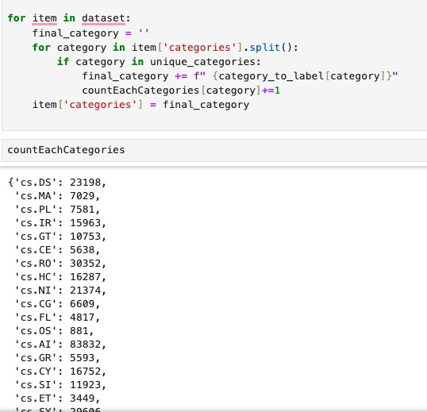
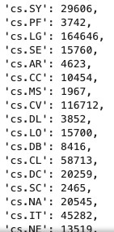
NLP
MODULE
Content Classifier
Dataset (json) get from Kaggle - arXiv Dataset
Consist of 1.7M+ scholar papers metadata
Only select CS category document
Remove the field beside CS category
Only title, abstract, and categories have been filter out for training purpose

Slide 7
DEMO SECTION

Slide 8

Challenges
Dataset too big
Lack of experience
WRAPPING
Future Work
UP
Continue implement all functionality of system
Train model and integrate to the system
Overall finished around 50% of system

Slide 9
THANK YOU
Q & A Session

